Slide 1
Output
Add Product

Slide 2
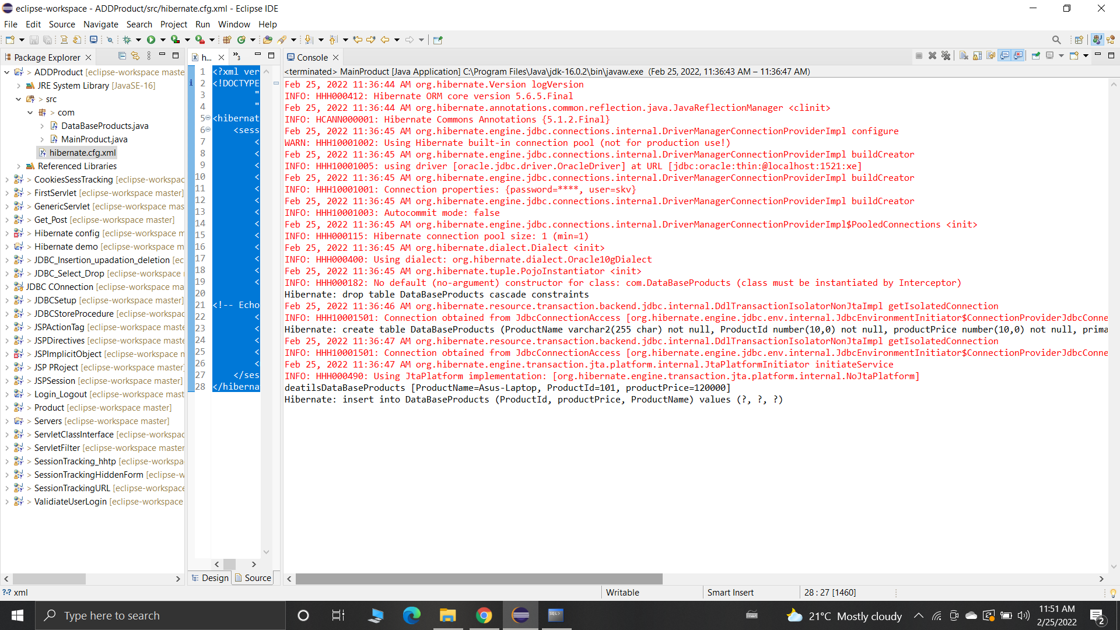

Slide 3
ThankYou

